Slide 1

Climate Change: A visual through environmental shifts
Duy Mai
Hoang-Uyen Tran
Twan Tran

Slide 2
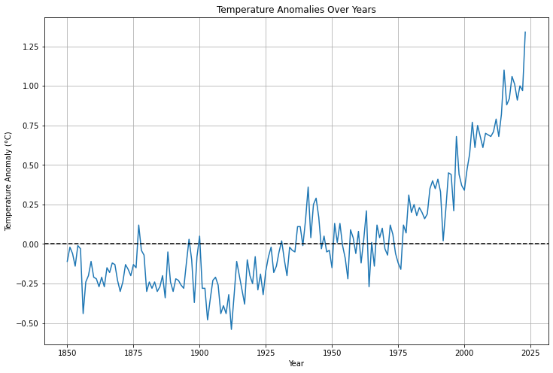
What is climate Change ?
Climate change, often referred to as global warming, or the greenhouse effect, is a change in the Earth's average temperature and cycles of weather patterns caused by human activities over a long period of time.
Since 1850, scientists have diligently documented global surface temperatures using thermometer-based records. The data trends depict a consistent rise in temperatures, indicating a warming trend across the planet. This observed temperature increase is a clear indication of the changing climate.
This is primarily because of the emission of greenhouse gases (GHGs) such as CO₂, CH₄, and N₂O. These GHGs act as a blanket in the Earth's atmosphere, trapping heat and causing the Earth's temperature to rise.
This increase in temperature can result in extreme weather events, rising sea levels, and disruptions to ecosystems.

Slide 3
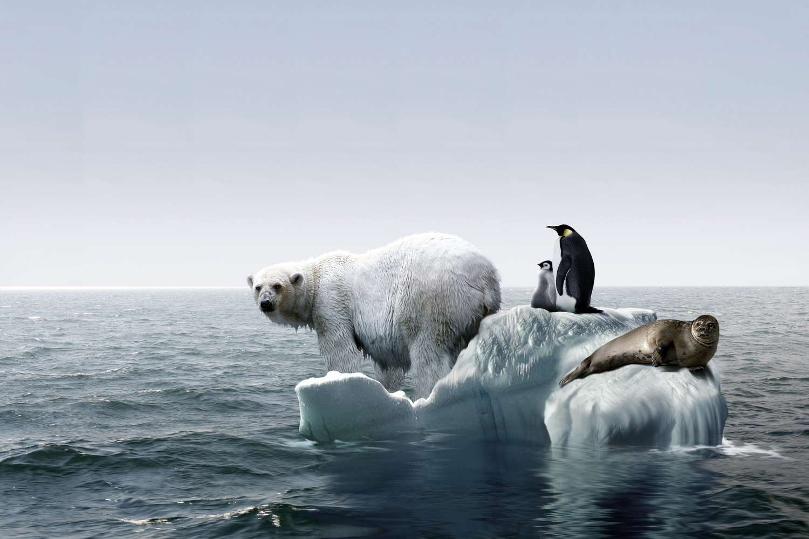
Why is It a problem?
Over the course of millions of years, species undergo gradual adaptations to survive within their specific environmental conditions. A stable climate is vital for this intricate process, fostering an environment where life forms can flourish and evolve. However, when the climate undergoes rapid changes, organisms face a challenge: the limited time available for adaptation to new conditions. Consequently, these swift alterations may render certain species unable to cope, threatening their survival in the changed environment.

Slide 4
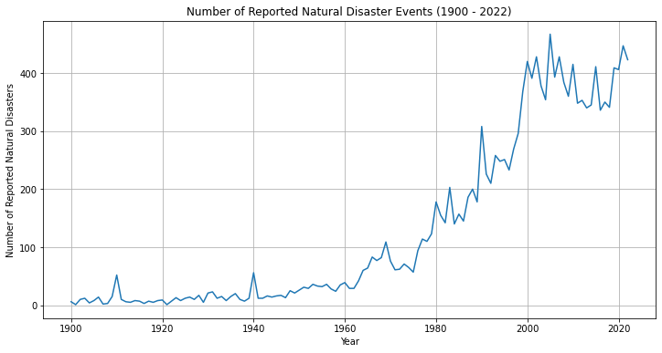
Why is It a problem?
Changes in the climate lead to disturbances in weather patterns, amplifying the frequency of extreme weather events. These encompass heightened hurricane activity, prolonged droughts, and escalated occurrences of floods. Concurrently, the surge in global temperatures parallels a noticeable uptick in documented natural disasters.

Slide 5
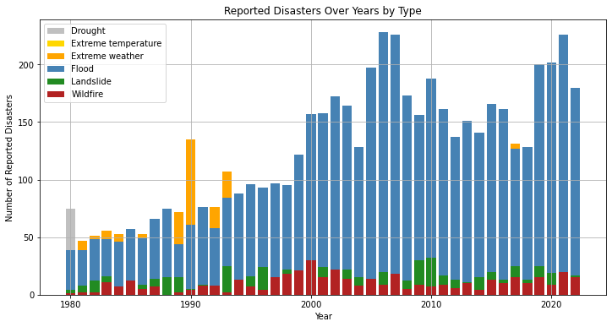
Bla Bla
Why is It a problem?

Slide 6
Why is It a problem?

Slide 7
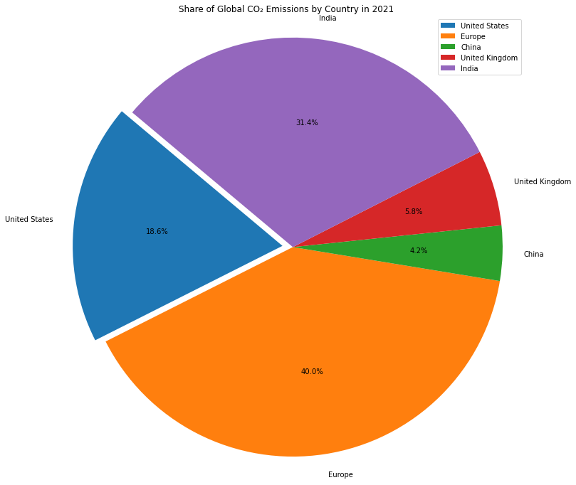
Who Causes climate change?
Around 1% of the greenhouse gases attributed to global warming are believed to have originated from the 50 least developed countries. In contrast, the contributions from the USA, the EU, and China alone account for approximately 60%.

